Slide 1
Lecture 1: Introduction
Kai-Wei Chang
CS @ UCLA
kw@kwchang.net
Couse webpage: https://uclanlp.github.io/CS269-17/

Slide 2
Announcements
Waiting list: Start attending the first few lectures as if you are registered. Given that some students will drop the class, some space will free up.
We will use Piazza as an online discussion platform. Please sign up here: piazza.com/ucla/fall2017/cs269

Slide 3
Staff
Instructor: Kai-Wei Chang
Email: ml17@kwchang.net
Office: BH 3732J
Office hour: 4:00 – 5:00, Tue (after class).
TA: Md Rizwan Parvez
Email: wua4nw@virginia.edu
Office: BH 3809
Office hour: 12:00 – 2:00, Wed

Slide 4
This lecture
Course Overview
What is NLP? Why it is important?
What types of ML methods used in NLP?
What will you learn from this course?
Course Information
What are the challenges?
Key NLP components
Key ML ideas in NLP

Slide 5
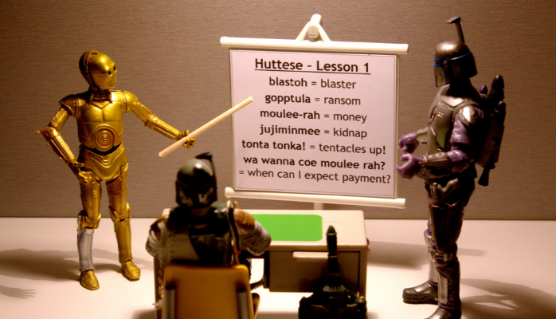
What is NLP
Wiki: Natural language processing (NLP) is a field of computer science, artificial intelligence, and computational linguistics concerned with the interactions between computers and human (natural) languages.

Slide 6
Go beyond the keyword matching
Identify the structure and meaning of words, sentences, texts and conversations
Deep understanding of broad language
NLP is all around us

Slide 7
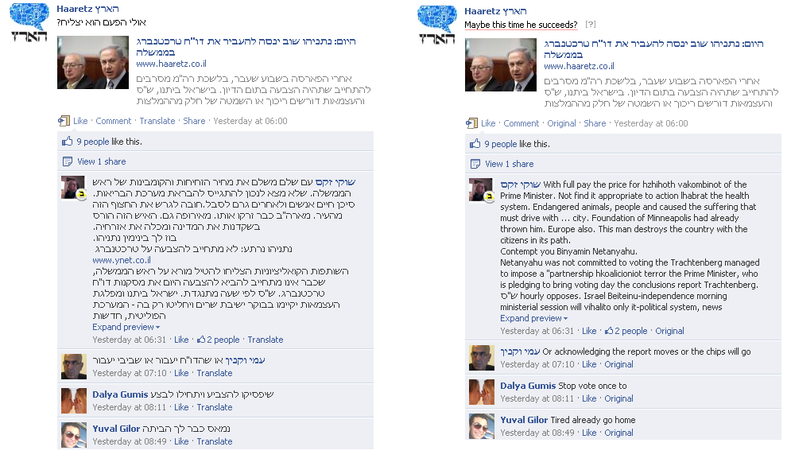
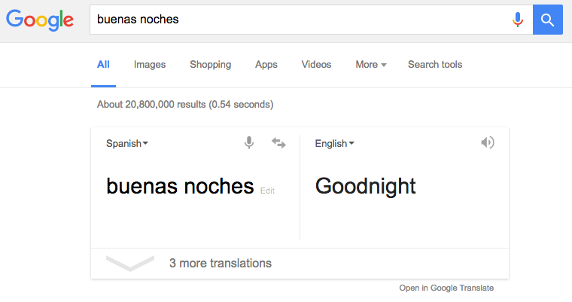
Machine translation
Facebook translation, image credit: Meedan.org

Slide 8
Statistical machine translation
Image credit: Julia Hockenmaier, Intro to NLP

Slide 9
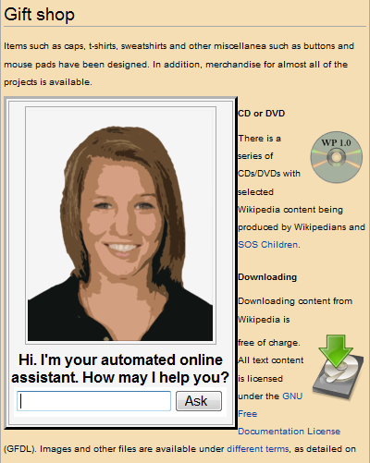
Dialog Systems

Slide 10
Sentiment/Opinion Analysis

Slide 11

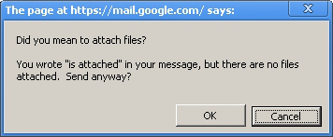
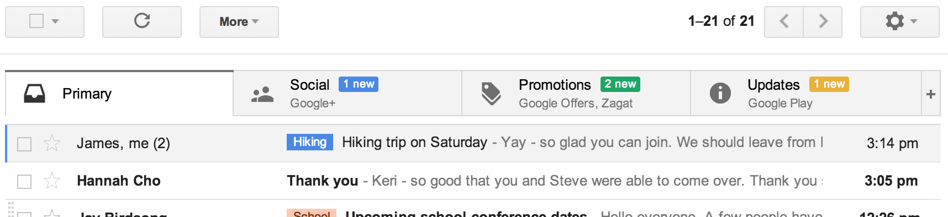
Text Classification
Other applications?
www.wired.com

Slide 12
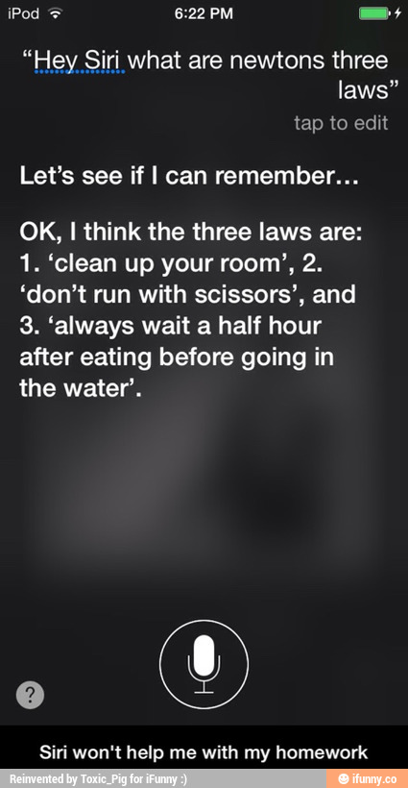
Question answering
'Watson' computer wins at 'Jeopardy'
credit: ifunny.com

Slide 13
Question answering
Go beyond search

Slide 14
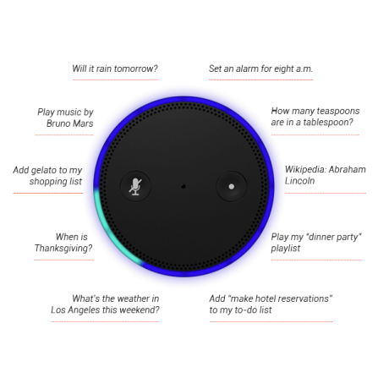
Natural language instruction
https://youtu.be/KkOCeAtKHIc?t=1m28s

Slide 15
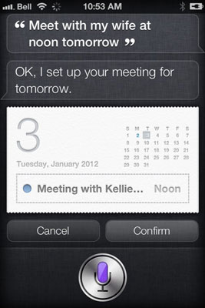
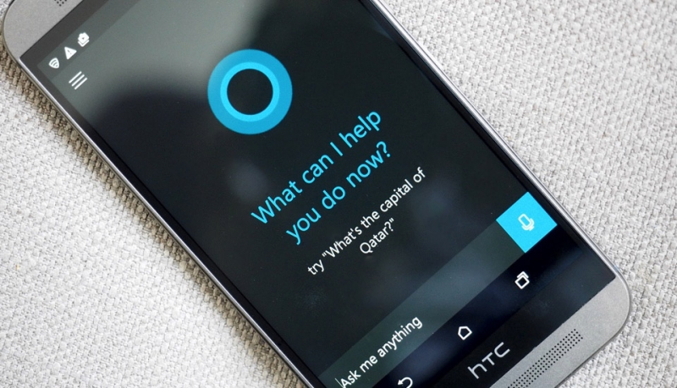
Digital personal assistant
More on natural language instruction
Semantic parsing – understand tasks
Entity linking – “my wife” = “Kellie” in the phone book
credit: techspot.com

Slide 16
Information Extraction
Unstructured text to database entries
Yoav Artzi: Natural language processing

Slide 17
Language Comprehension
Q: who wrote Winnie the Pooh?
Q: where is Chris lived?
Christopher Robin is alive and well. He is the same person that you read about in the book, Winnie the Pooh. As a boy, Chris lived in a pretty home called Cotchfield Farm. When Chris was three years old, his father wrote a poem about him. The poem was printed in a magazine for others to read. Mr. Robin then wrote a book

Slide 18
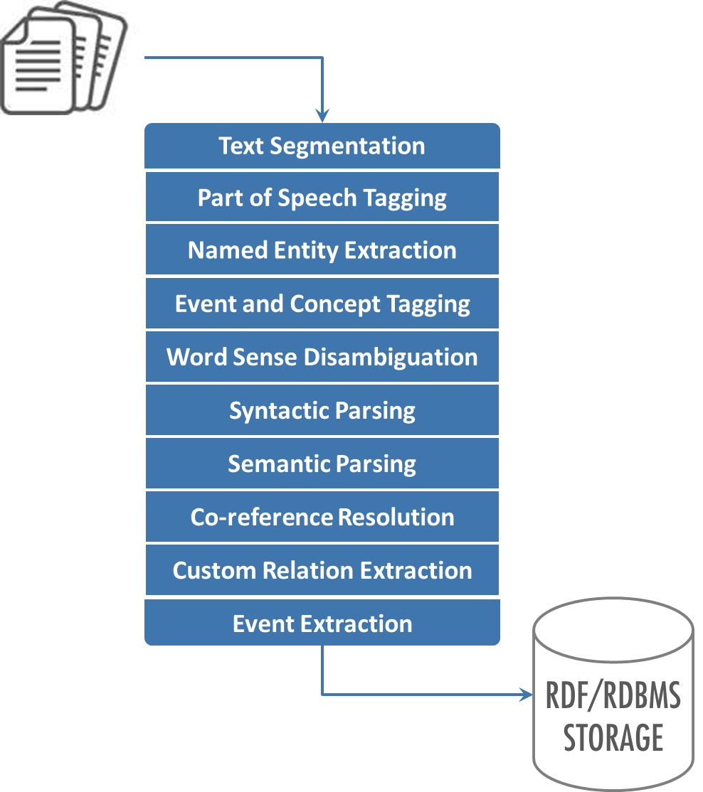
What will you learn from this course
The NLP Pipeline
Key components for understanding text
NLP systems/applications
Current techniques & limitation
Build realistic NLP tools

Slide 19
What’s not covered by this course
Speech recognition – no signal processing
Natural language generation
Details of ML algorithms / theory
Text mining / information retrieval

Slide 20
This lecture
Course Overview
What is NLP? Why it is important?
What will you learn from this course?
Course Information
What are the challenges?
Key NLP components

Slide 21
Overview
New course, first time being offered
Comments are welcomed
target at first- or second- year PhD students
Lecture + Seminar
No course prerequisites, but I assume
programming experience (for the final project)
basic ML/AI background
basics of probability calculus, and linear algebra (HW0)

Slide 22

Grading
Attendance & participations (10%)
Participate in discussion
Paper summarization report (20%)
Paper presentation (30%)
Final project (40%)
Proposal (5%)
Final Paper (25%)
Presentation (10%)

Slide 23
Paper summarization
1 page maximum
Pick one paper from recent ACL/NAACL/EMNLP/EACL
Summarize the paper (use you own words)
Write a blog post using markdown or jupyter notebook:
https://einstein.ai/research/learned-in-translation-contextualized-word-vectors
https://github.com/uclanlp/reducingbias/blob/master/src/fairCRF_gender_ratio.ipynb

Slide 24
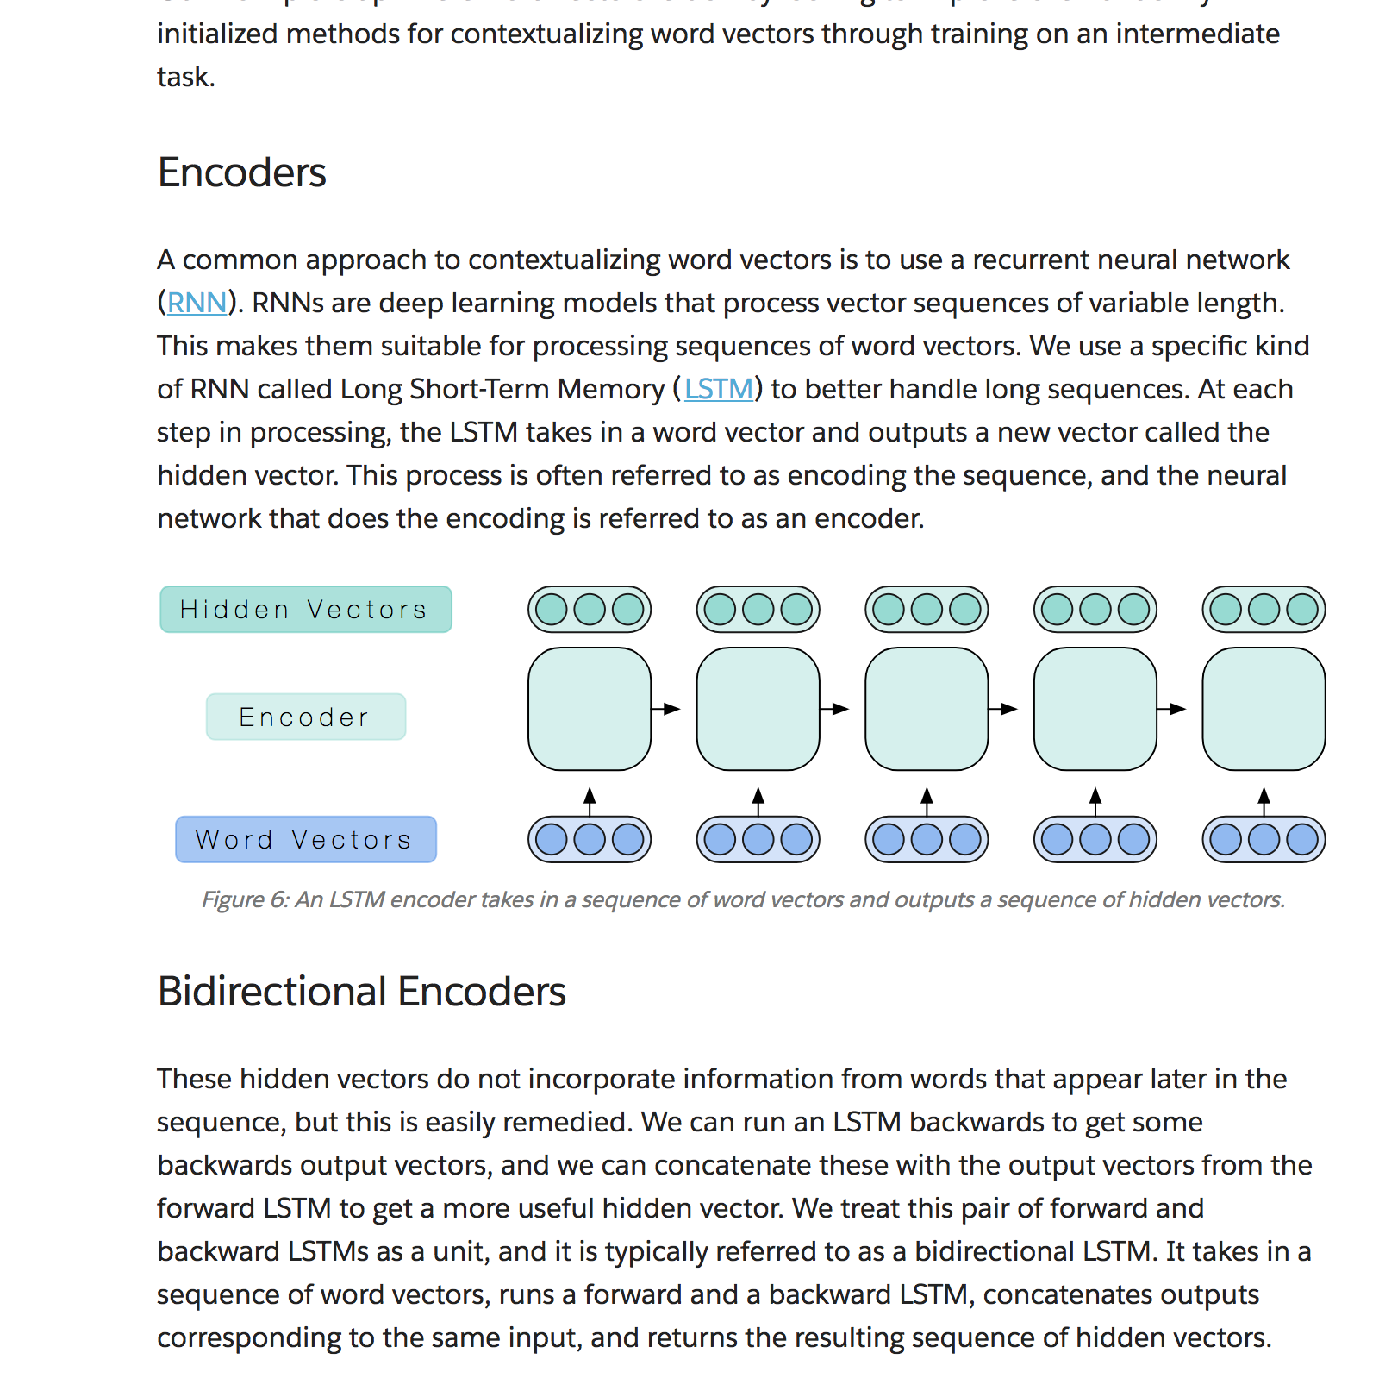

Slide 25
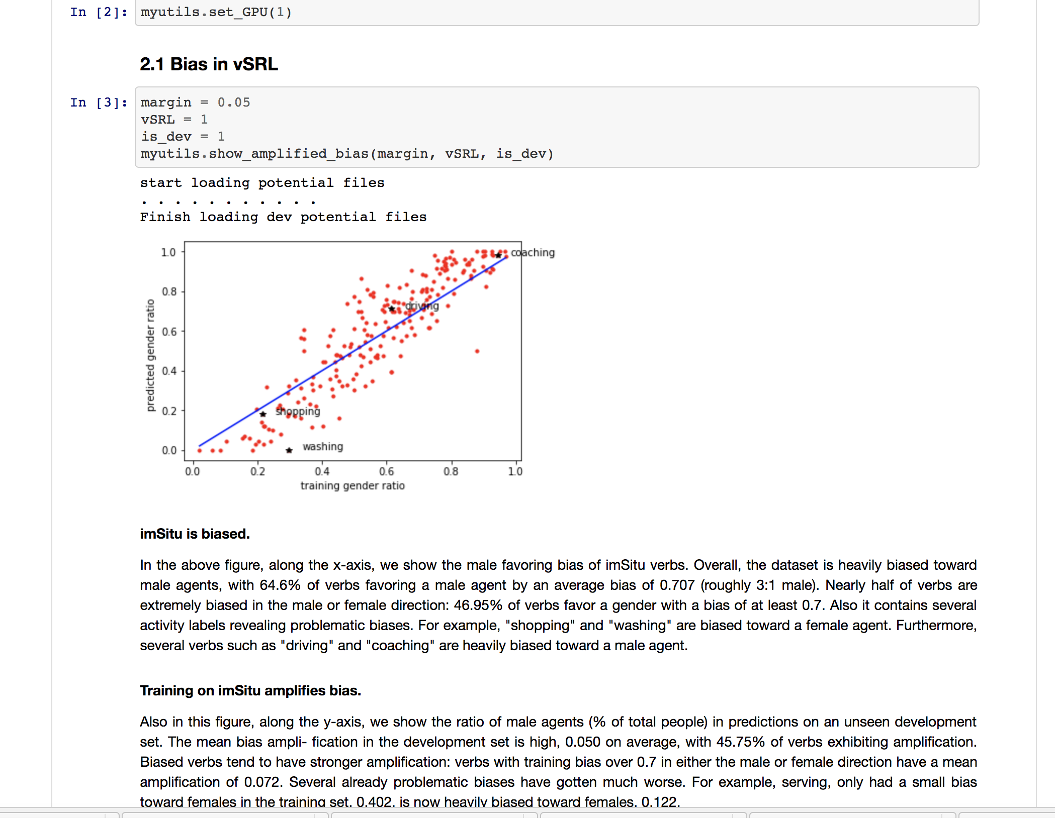

Slide 26
Paper presentation
Each group has 2~3 students
Read and understand 2~3 related papers
Cannot be the same as your paper summary
Can be related to your final project
Register your choice next week
30 min presentation/ Q&A
Grading Rubric: 40% technical understanding, 40% presentation, 20% interaction

Slide 27
Final Project
Work in groups (3 students)
Project proposal
1 page maximum (template)
Project report
Similar to the paper summary
Due before the final presentation
Project presentation
in-class presentation (tentative)

Slide 28
Late Policy
Submission site will be closed 1hr after the deadline.
No late submission
unless under emergency situation

Slide 29
Cheating/Plagiarism
No. Ask if you have concerns
Rules of thumb:
Cite your references
Clearly state what are your contributions

Slide 30
Lectures and office hours
Participation is highly appreciated!
Ask questions if you are still confusing
Feedbacks are welcomed
Lead the discussion in this class
Enroll Piazza

Slide 31
Topics of this class
Fundamental NLP problems
Machine learning & statistical approaches for NLP
NLP applications
Recent trends in NLP

Slide 32
What to Read?
Natural Language Processing ACL, NAACL, EACL, EMNLP, CoNLL, Coling, TACL aclweb.org/anthology
Machine learning ICML, NIPS, ECML, AISTATS, ICLR, JMLR, MLJ
Artificial Intelligence AAAI, IJCAI, UAI, JAIR

Slide 33
Questions?

Slide 34
This lecture
Course Overview
What is NLP? Why it is important?
What will you learn from this course?
Course Information
What are the challenges?
Key NLP components
Key ML ideas in NLP

Slide 35
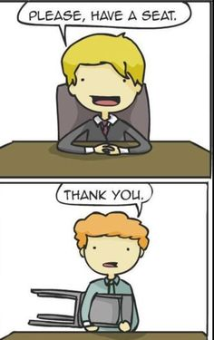
Challenges – ambiguity
Word sense ambiguity

Slide 36
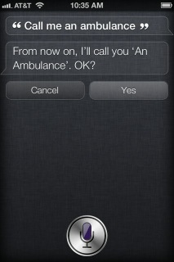
Challenges – ambiguity
Word sense / meaning ambiguity
Credit: http://stuffsirisaid.com

Slide 37
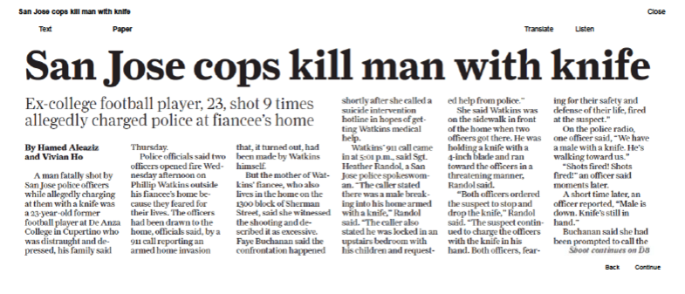
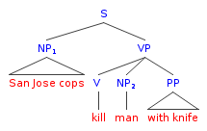
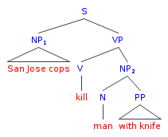
Challenges – ambiguity
PP attachment ambiguity
Credit: Mark Liberman, http://languagelog.ldc.upenn.edu/nll/?p=17711

Slide 38
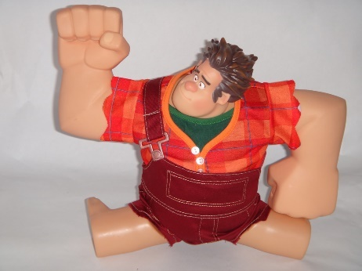

Challenges -- ambiguity
Ambiguous headlines:
Include your children when baking cookies
Local High School Dropouts Cut in Half
Hospitals are Sued by 7 Foot Doctors
Iraqi Head Seeks Arms
Safety Experts Say School Bus Passengers Should Be Belted
Teacher Strikes Idle Kids

Slide 39
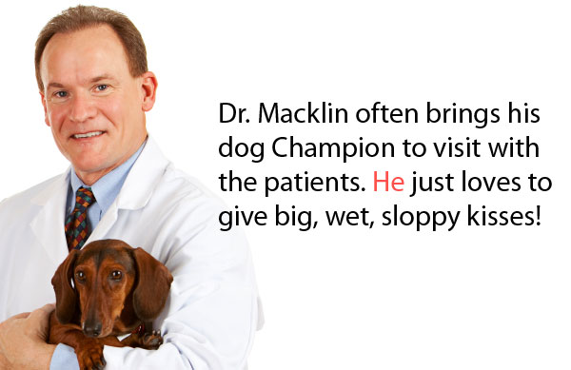
Challenges – ambiguity
Pronoun reference ambiguity
Credit: http://www.printwand.com/blog/8-catastrophic-examples-of-word-choice-mistakes

Slide 40
Challenges – language is not static
Language grows and changes
e.g., cyber lingo
LOL | Laugh out loud
G2G | Got to go
BFN | Bye for now
B4N | Bye for now
Idk | I don’t know
FWIW | For what it’s worth
LUWAMH | Love you with all my heart

Slide 41

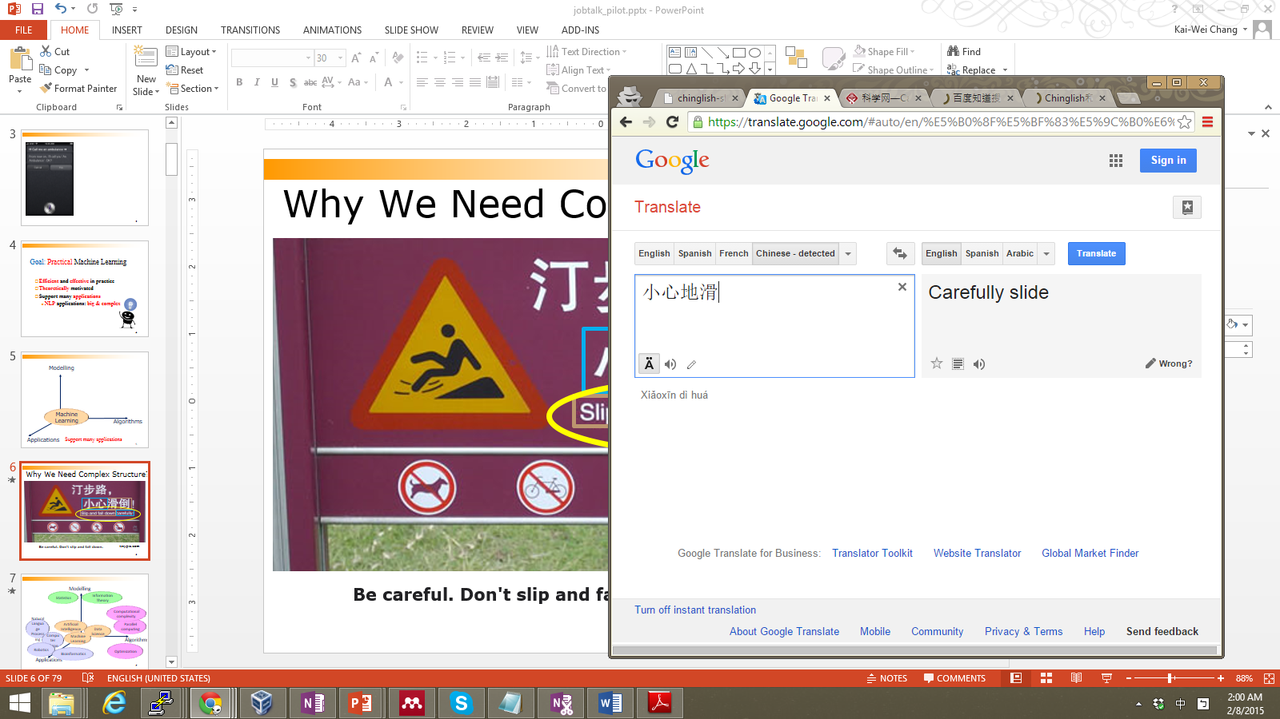
Challenges--language is compositional
Carefully Slide

Slide 42
Challenges--language is compositional
小心:
Carefully
Careful
Take Care
Caution
地滑:
Slide
Landslip
Wet Floor
Smooth

Slide 43
Challenges – scale
Examples:
Bible (King James version): ~700K
Penn Tree bank ~1M from Wall street journal
Newswire collection: 500M+
Wikipedia: 2.9 billion word (English)
Web: several billions of words

Slide 44
This lecture
Course Overview
What is NLP? Why it is important?
What will you learn from this course?
Course Information
What are the challenges?
Key NLP components
Key ML ideas in NLP

Slide 45
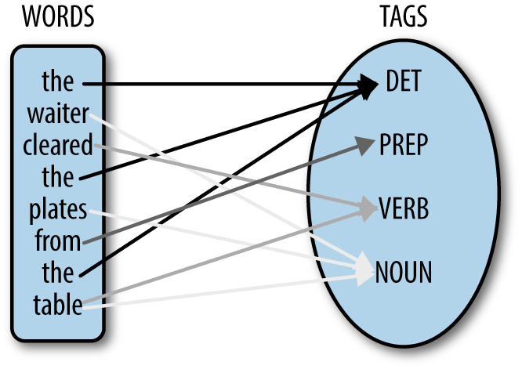
Part of speech tagging

Slide 46
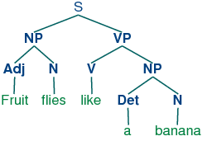
Syntactic (Constituency) parsing

Slide 47
Syntactic structure => meaning
Image credit: Julia Hockenmaier, Intro to NLP

Slide 48
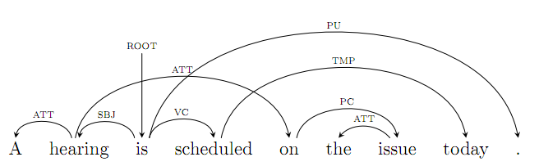
Dependency Parsing

Slide 49
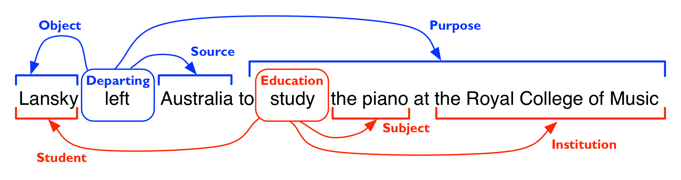
Semantic analysis
Word sense disambiguation
Semantic role labeling
Credit: Ivan Titov

Slide 50
Q: [Chris] = [Mr. Robin] ?
Christopher Robin is alive and well. He is the same person that you read about in the book, Winnie the Pooh. As a boy, Chris lived in a pretty home called Cotchfield Farm. When Chris was three years old, his father wrote a poem about him. The poem was printed in a magazine for others to read. Mr. Robin then wrote a book
Slide modified from Dan Roth

Slide 51
Co-reference Resolution
Christopher Robin is alive and well. He is the same person that you read about in the book, Winnie the Pooh. As a boy, Chris lived in a pretty home called Cotchfield Farm. When Chris was three years old, his father wrote a poem about him. The poem was printed in a magazine for others to read. Mr. Robin then wrote a book

Slide 52
This lecture
Course Overview
What is NLP? Why it is important?
What will you learn from this course?
Course Information
What are the challenges?
Key NLP components
Key ML ideas in NLP

Slide 53
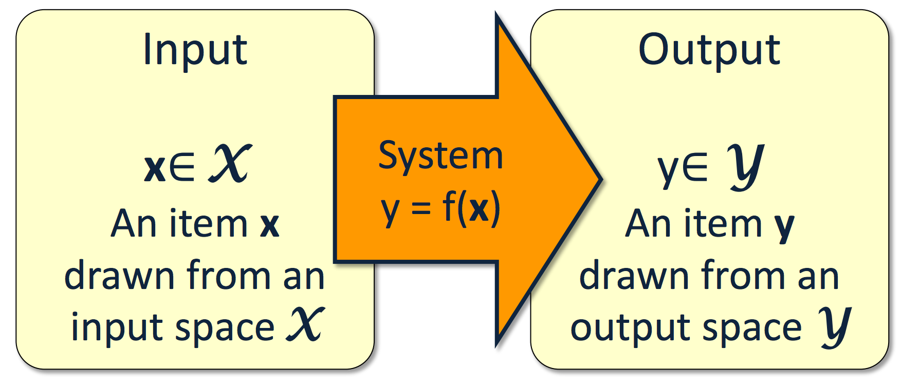
Machine learning 101

Slide 54
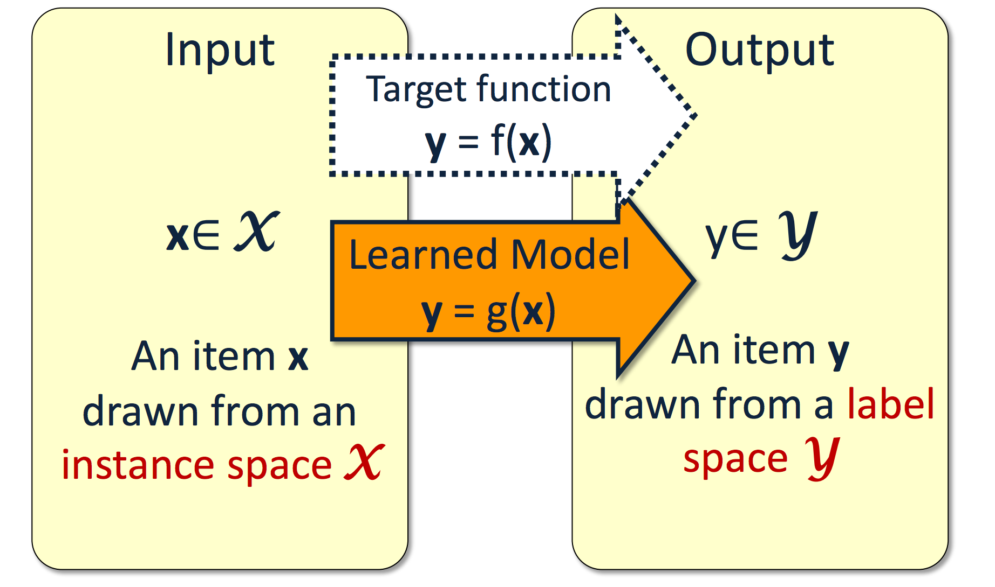

Slide 55
Perceptron, decision tree, support vector machine K-NN, Naïve Bayes, logistic regression….

Slide 56
Classification is generally well-understood
Theoretically: generalization bound
# examples to train a good model
Algorithmically:
Efficient algorithm for large data set
E.g., take a few second to train a linear SVM on data with millions instances and features
Algorithms for non-linear model
E.g., Kernel methods
Is this enough to solve all real-world problems?

Slide 57
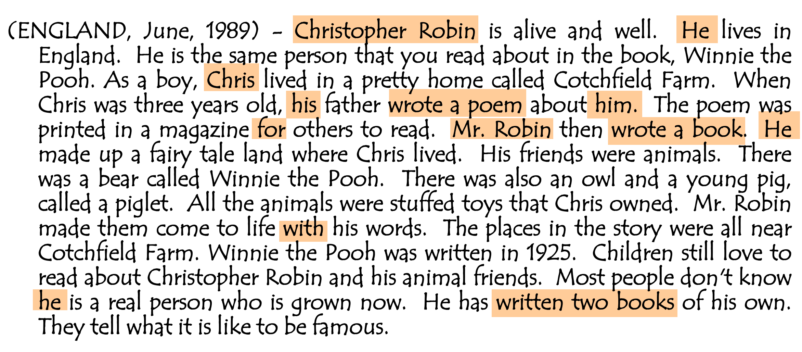
Reading Comprehension

Slide 58
Challenges
Modeling challenges
How to model a complex decision?
Representation challenges
How to extract features?
Algorithmic challenges
Large amount of data and complex decision structure
Algorithm 2 is shown to perform better Berg-Kirkpatrick, ACL 2010. It can also be expected to converge faster -- anyway, the E-step changes the auxiliary function by changing the expected counts, so there's no point in finding a local maximum of the auxiliary
function in each iteration
a local-optimality guarantee. Consequently, LOLS can improve upon the reference policy, unlike previous algorithms. This enables us to develop structured contextual bandits, a partial information structured prediction setting with many potential applications.
Robin is alive and well. He is the same person that you read about in the book, Winnie the Pooh. As a boy, Chris lived in a pretty home called Cotchfield Farm. When Chris was three years old, his father wrote a poem about him. The poem was printed in a magazine for others to read. Mr. Robin then wrote a book
Methods for learning to search for structured prediction typically imitate a reference policy, with existing theoretical guarantees demonstrating low regret compared to that reference. This is unsatisfactory in many applications where the reference policy is suboptimal and the goal of learning is to
Can learning to search work even when the reference is poor? We provide a new learning to search algorithm, LOLS, which does well relative to the reference policy, but additionally guarantees low regret compared to deviations from the learned policy.
Bill Clinton, recently elected as the President of the USA, has been invited by the Russian President], [Vladimir Putin, to visit Russia. President Clinton said that he looks forward to strengthening ties between USA ^{and Russia}
Robin is alive and well. He is the same person that you read about in the book, Winnie the Pooh. As a boy, Chris lived in a pretty home called Cotchfield Farm. When Chris was three years old, his father wrote a poem about him. The poem was printed in a magazine for others to read. Mr. Robin then wrote a book
Structured prediction models
Deep learning models
Inference / learning algorithms

Slide 59
Modeling Challenges
How to model a complex decision?
Why this is important?
Robin is alive and well. He is the same person that you read about in the book, Winnie the Pooh. As a boy, Chris lived in a pretty home called Cotchfield Farm. When Chris was three years old, his father wrote a poem about him. The poem was printed in a magazine for others to read. Mr. Robin then wrote a book

Slide 60
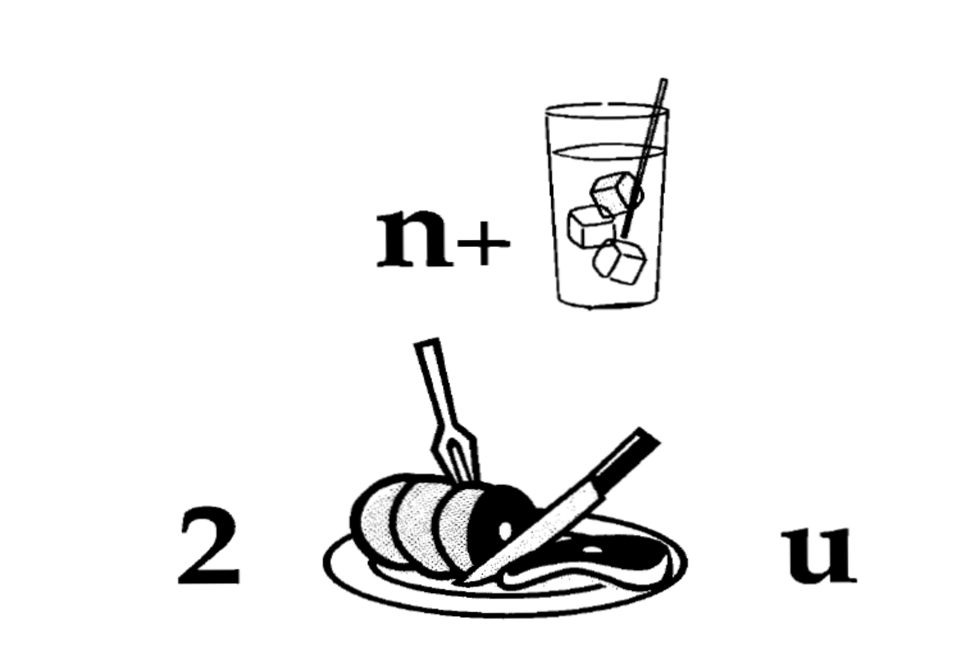
Language is structural

Slide 61

Hand written recognition
What is this letter?

Slide 62

Hand written recognition
What is this letter?

Slide 63


Visual recognition

Slide 64
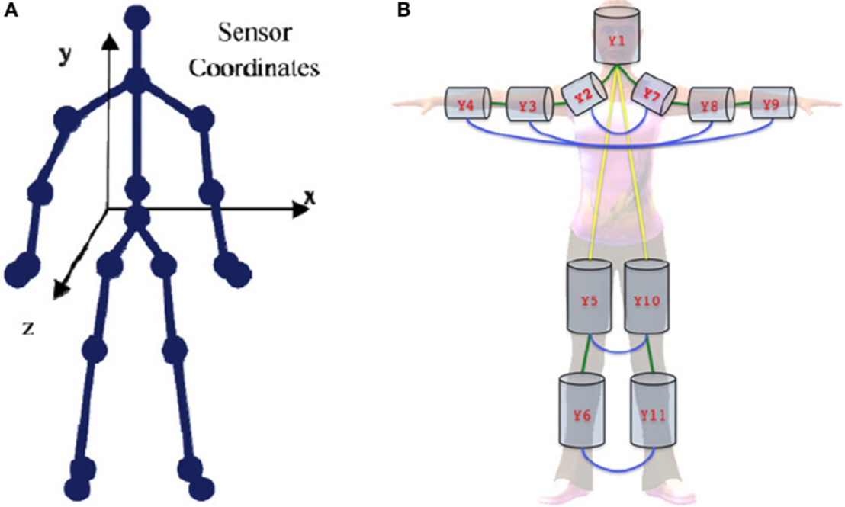
Human body recognition

Slide 65
Bridge the gap
Simple classifiers are not designed for handle complex output
Need to make multiple decisions jointly
Example: POS tagging:
can you can a can as a canner can can a can
Example from Vivek Srikumar

Slide 66
Make multiple decisions jointly
Example: POS tagging:
Each part needs a label
Assign tag (V., N., A., …) to each word in the sentence
The decisions are mutually dependent
Cannot have verb followed by a verb
Results are evaluated jointly
can you can a can as a canner can can a can

Slide 67
Structured prediction problems
Problems that
have multiple interdependent output variables
and the output assignments are evaluated jointly
Need a joint assignment to all the output variables
We called it joint inference, global infernece or simply inference

Slide 68
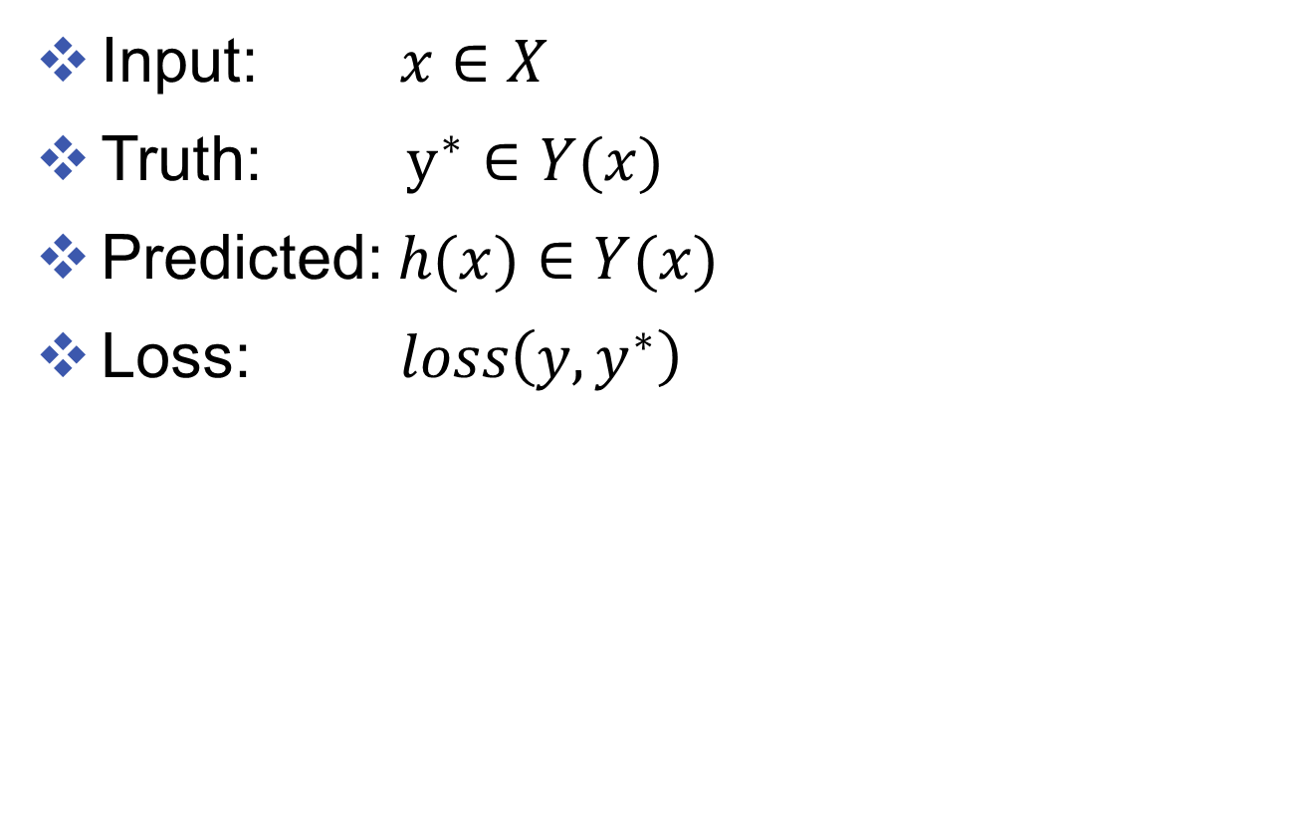
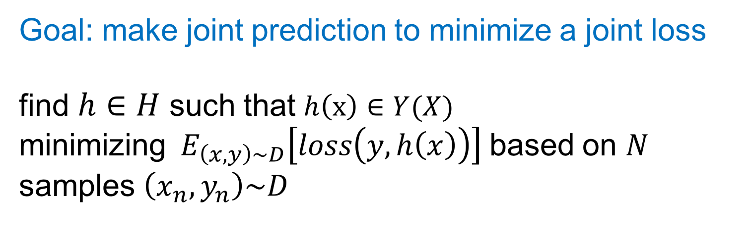
A General learning setting
I
can
can
a
can
Input: $x∈X$
Truth: $y^{∗}∈Y(x)$
Predicted: $h(x)∈Y(x)$
Loss: $loss\left(y, y^{∗}\right)$
Pro
Md
Vb
Dt
Nn
Pro
Md
Md
Dt
Vb
Pro
Md
Md
Dt
Nn
Pro
Md
Nn
Dt
Md
Pro
Md
Nn
Dt
Vb
Goal: make joint prediction to minimize a joint loss
find $h∈H$ such that $h\left(x\right)∈Y(X)$ minimizing$E_{\left(x,y\right)\sim D}\left[loss\left(y, h\left(x\right)\right)\right]$ based on $N$ samples $\left(x_{n},y_{n}\right)\sim D$

Slide 69
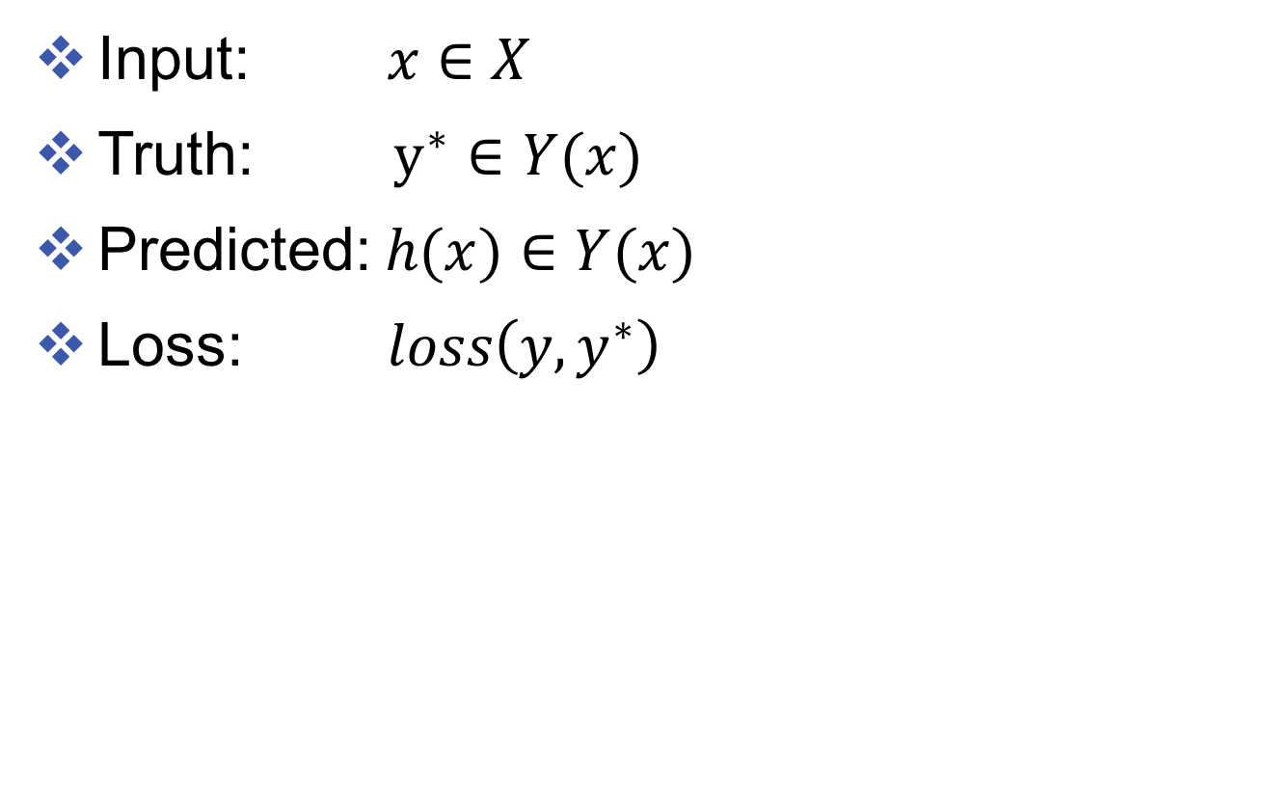
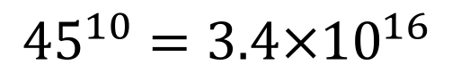
Combinatorial output space
I
can
can
a
can
Input: $x∈X$
Truth: $y^{∗}∈Y(x)$
Predicted: $h(x)∈Y(x)$
Loss: $loss\left(y, y^{∗}\right)$
Pro
Md
Vb
Dt
Nn
Pro
Md
Md
Dt
Vb
Pro
Md
Md
Dt
Nn
Pro
Md
Nn
Dt
Md
Pro
Md
Nn
Dt
Vb
# POS tags: 45
How many possible outputs for sentence with 10 words?
$${45}^{10}=3.4×{10}^{16}$$
Observation: Not all sequences are valid,
and we don’t need to consider all of them

Slide 70
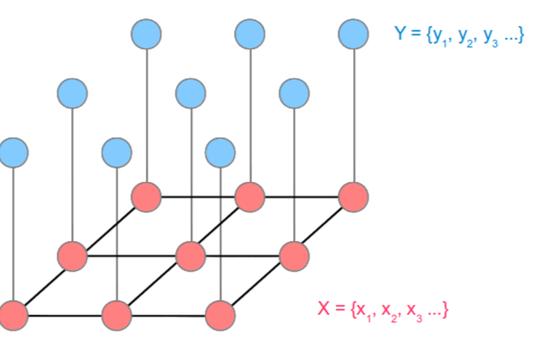
Representation of interdependent output variables
A compact way to represent output combinations
Abstract away unnecessary complexities
We know how to process them
Graph algorithms for linear chain, tree, etc.
Pronoun
Verb
Noun
And
Noun
Root They operate ships and banks .

Slide 71
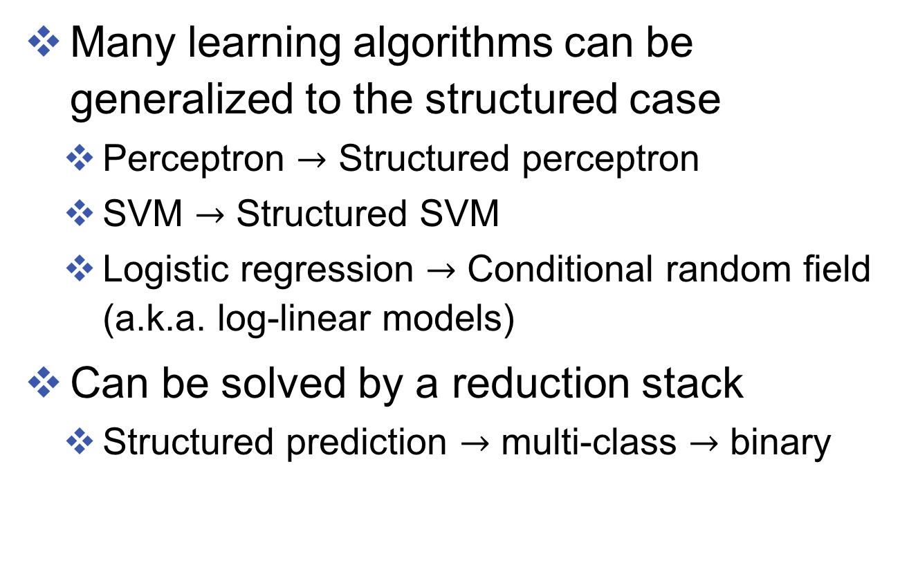
Algorithms/models for structured prediction
Many learning algorithms can be generalized to the structured case
Perceptron $→$ Structured perceptron
SVM $→$ Structured SVM
Logistic regression $→$ Conditional random field (a.k.a. log-linear models)
Can be solved by a reduction stack
Structured prediction $→$ multi-class $→$ binary

Slide 72
Representation Challenges
How to obtain features?
Robin is alive and well. He is the same person that you read about in the book, Winnie the Pooh. As a boy, Chris lived in a pretty home called Cotchfield Farm. When Chris was three years old, his father wrote a poem about him. The poem was printed in a magazine for others to read. Mr. Robin then wrote a book

Slide 73
Representation Challenges
How to obtain features?
Design features based on domain knowledge
E.g., by patterns in parse trees
By nicknames
Need human experts/knowledge
When Chris was three years old, his father wrote a poem about him.
Christopher Robin is alive and well. He is the same person that you read about in the book, Winnie the Pooh. As a boy, Chris lived in a pretty home called Cotchfield Farm.

Slide 74
Representation Challenges
How to obtain features?
Design features based on domain knowledge
Design feature templates and then let machine find the right ones
E.g., use all words, pairs of words, …
Robin is alive and well. He is the same person that you read about in the book, Winnie the Pooh. As a boy, Chris lived in a pretty home called Cotchfield Farm. When Chris was three years old, his father wrote a poem about him. The poem was printed in a magazine for others to read. Mr. Robin then wrote a book

Slide 75
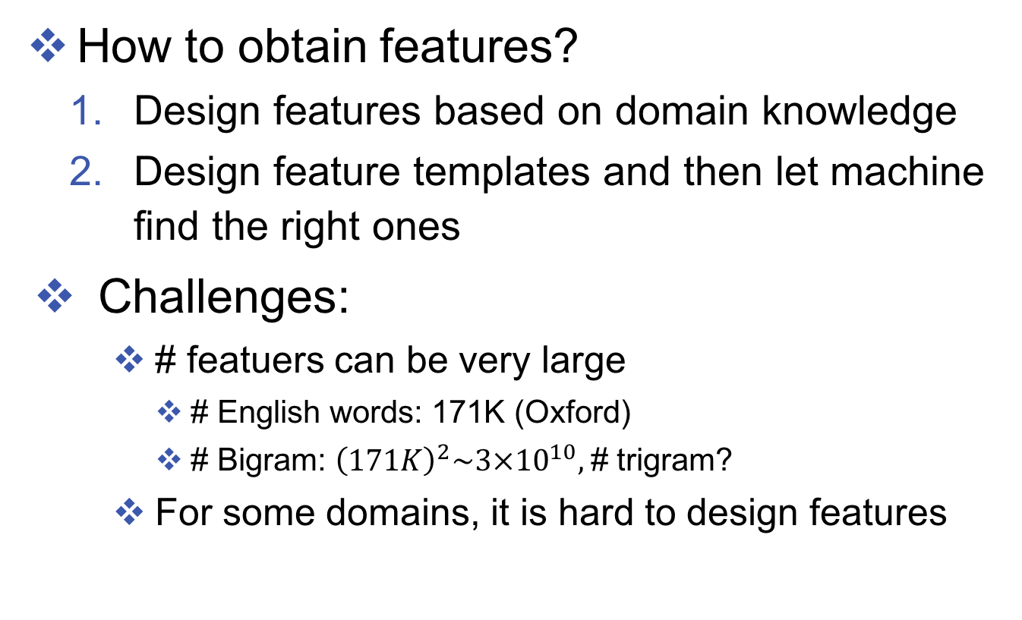
Representation Challenges
How to obtain features?
Design features based on domain knowledge
Design feature templates and then let machine find the right ones
Challenges:
# featuers can be very large
# English words: 171K (Oxford)
# Bigram: ${\left(171K\right)}^{2}\sim 3×{10}^{10},$# trigram?
For some domains, it is hard to design features

Slide 76
Representation learning
Learn compact representations of features
Combinatorial (continuous representation)

Slide 77
Representation learning
Learn compact representations of features
Combinatorial (continuous representation)
Hieratical/compositional

Slide 78
What will learn from this course
Structured prediction
Models / inference/ learning
Representation (deep) learning
Input/output representations
Combining structured models and deep learning

